Slide 1


HOW WE DO ACCESSIBILITY AT NAV
Vegard Haugstvedt
Frontend developer and accessibility specialist
Notes:
Welcome! Today I am happy to show off how we work in NAV on accessibility and universal design.
I am Vegard Haugstvedt, and I work at NAV as a frontend developer and accessibility specialist, and that is about all I will say about me today.
Just to set the stage, I need to present our organization.
NAV has one of, if not the largest IT departments in the public sector in Norway.
This of course allows us to have more specialized roles and dedicated teams, but it also creates many challenges when it comes to scaling what we do.

Slide 2
NAV in numbers
800 employees in NAV IT
8 product teams
92 product teams
2000+ public GitHub repos
1600 deploys each week
Ranging from 38 to 119 people

Slide 3
Scaling knowledge
Avoid individual responsibility
01
Scale knowledge, not work
02
Create «Fart & Flyt»
03
It does not mean what you think it does!

Slide 4
Roles in NAV IT
799 Developers
77 Designers
71 Lawyers
30 Data scientists
180 Subject experts
22% Consultants
Notes:
599 developers
77 designers
71 lawyers
30 data scientists
180 subject experts
22% consultants

Slide 5
What we will cover
Accessibility team
Design system team
In-team accessibility work

Slide 6
Accessibility team
… or -group, -cluster or something else…

Slide 7
Team responsibilities
Training
Consulting
Empathy lab and test lab
Accessibility statement
Tender processes
Law interpretation

Slide 8
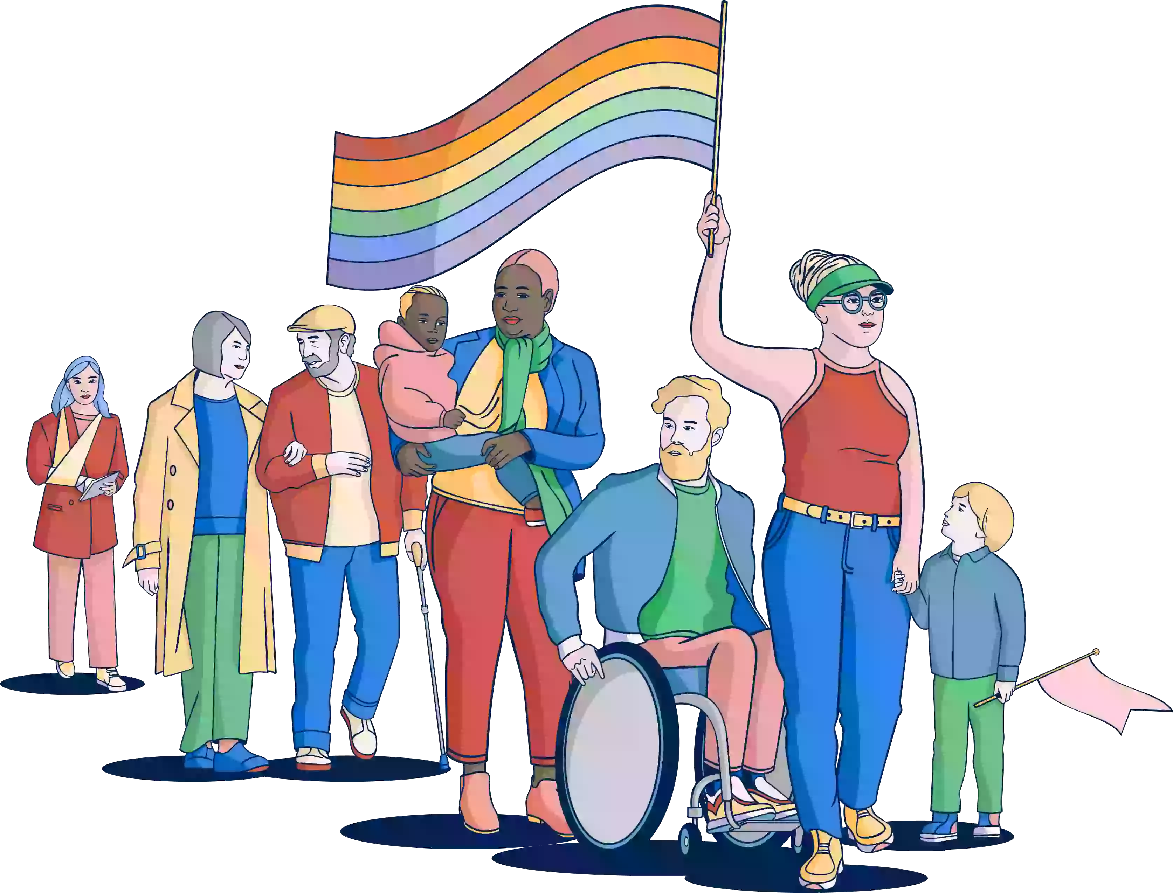
Training
Presentations
Best practice guides
UU-forum
Conference: Mangfold i mai
Notes:
Probably the most important thing to get such a large organization to manage accessibility in a responsible way is to spread knowledge.
There are simply never going to be enough experts to make sure that all these teams, developers and designers don’t mess up.
And let me just say that not messing up should not be your focus, because that is setting the bar too low.
Accessibility, as defined in WCAG, the international standard for accessibility on the web, should be regarded as the low bar or the bare minimum.
We want our teams to produce solutions that are actually easy to use.
If we were to run around testing and policing what the teams did, we would a large department just for that.
Instead, we focus our time on spreading knowledge and assisting the teams where they request it.

Slide 9
Consulting
Upon request from product teams
Guided reviews
Workshops
Deployed to a team

Slide 10
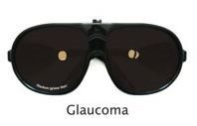
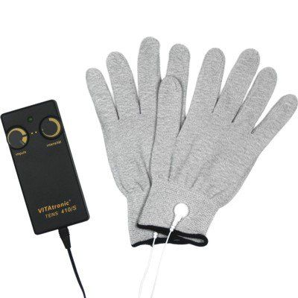
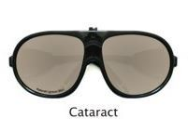
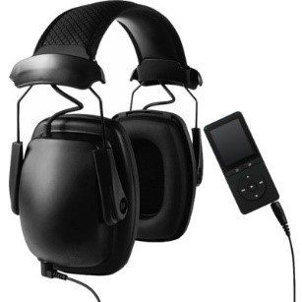
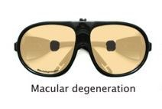
Empathy lab

Slide 11
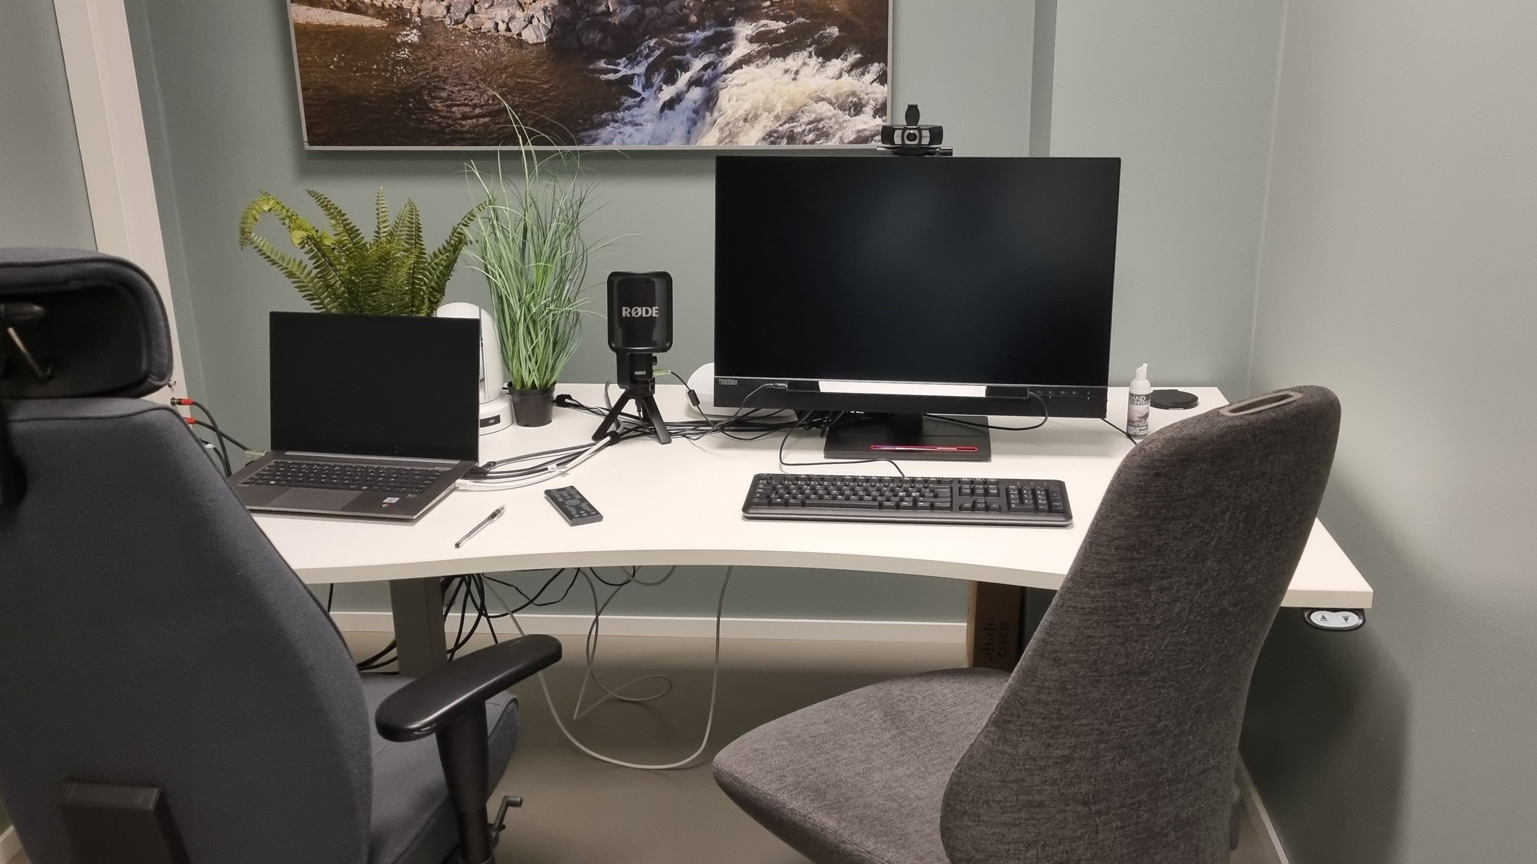
Test lab with eye tracking

Slide 12
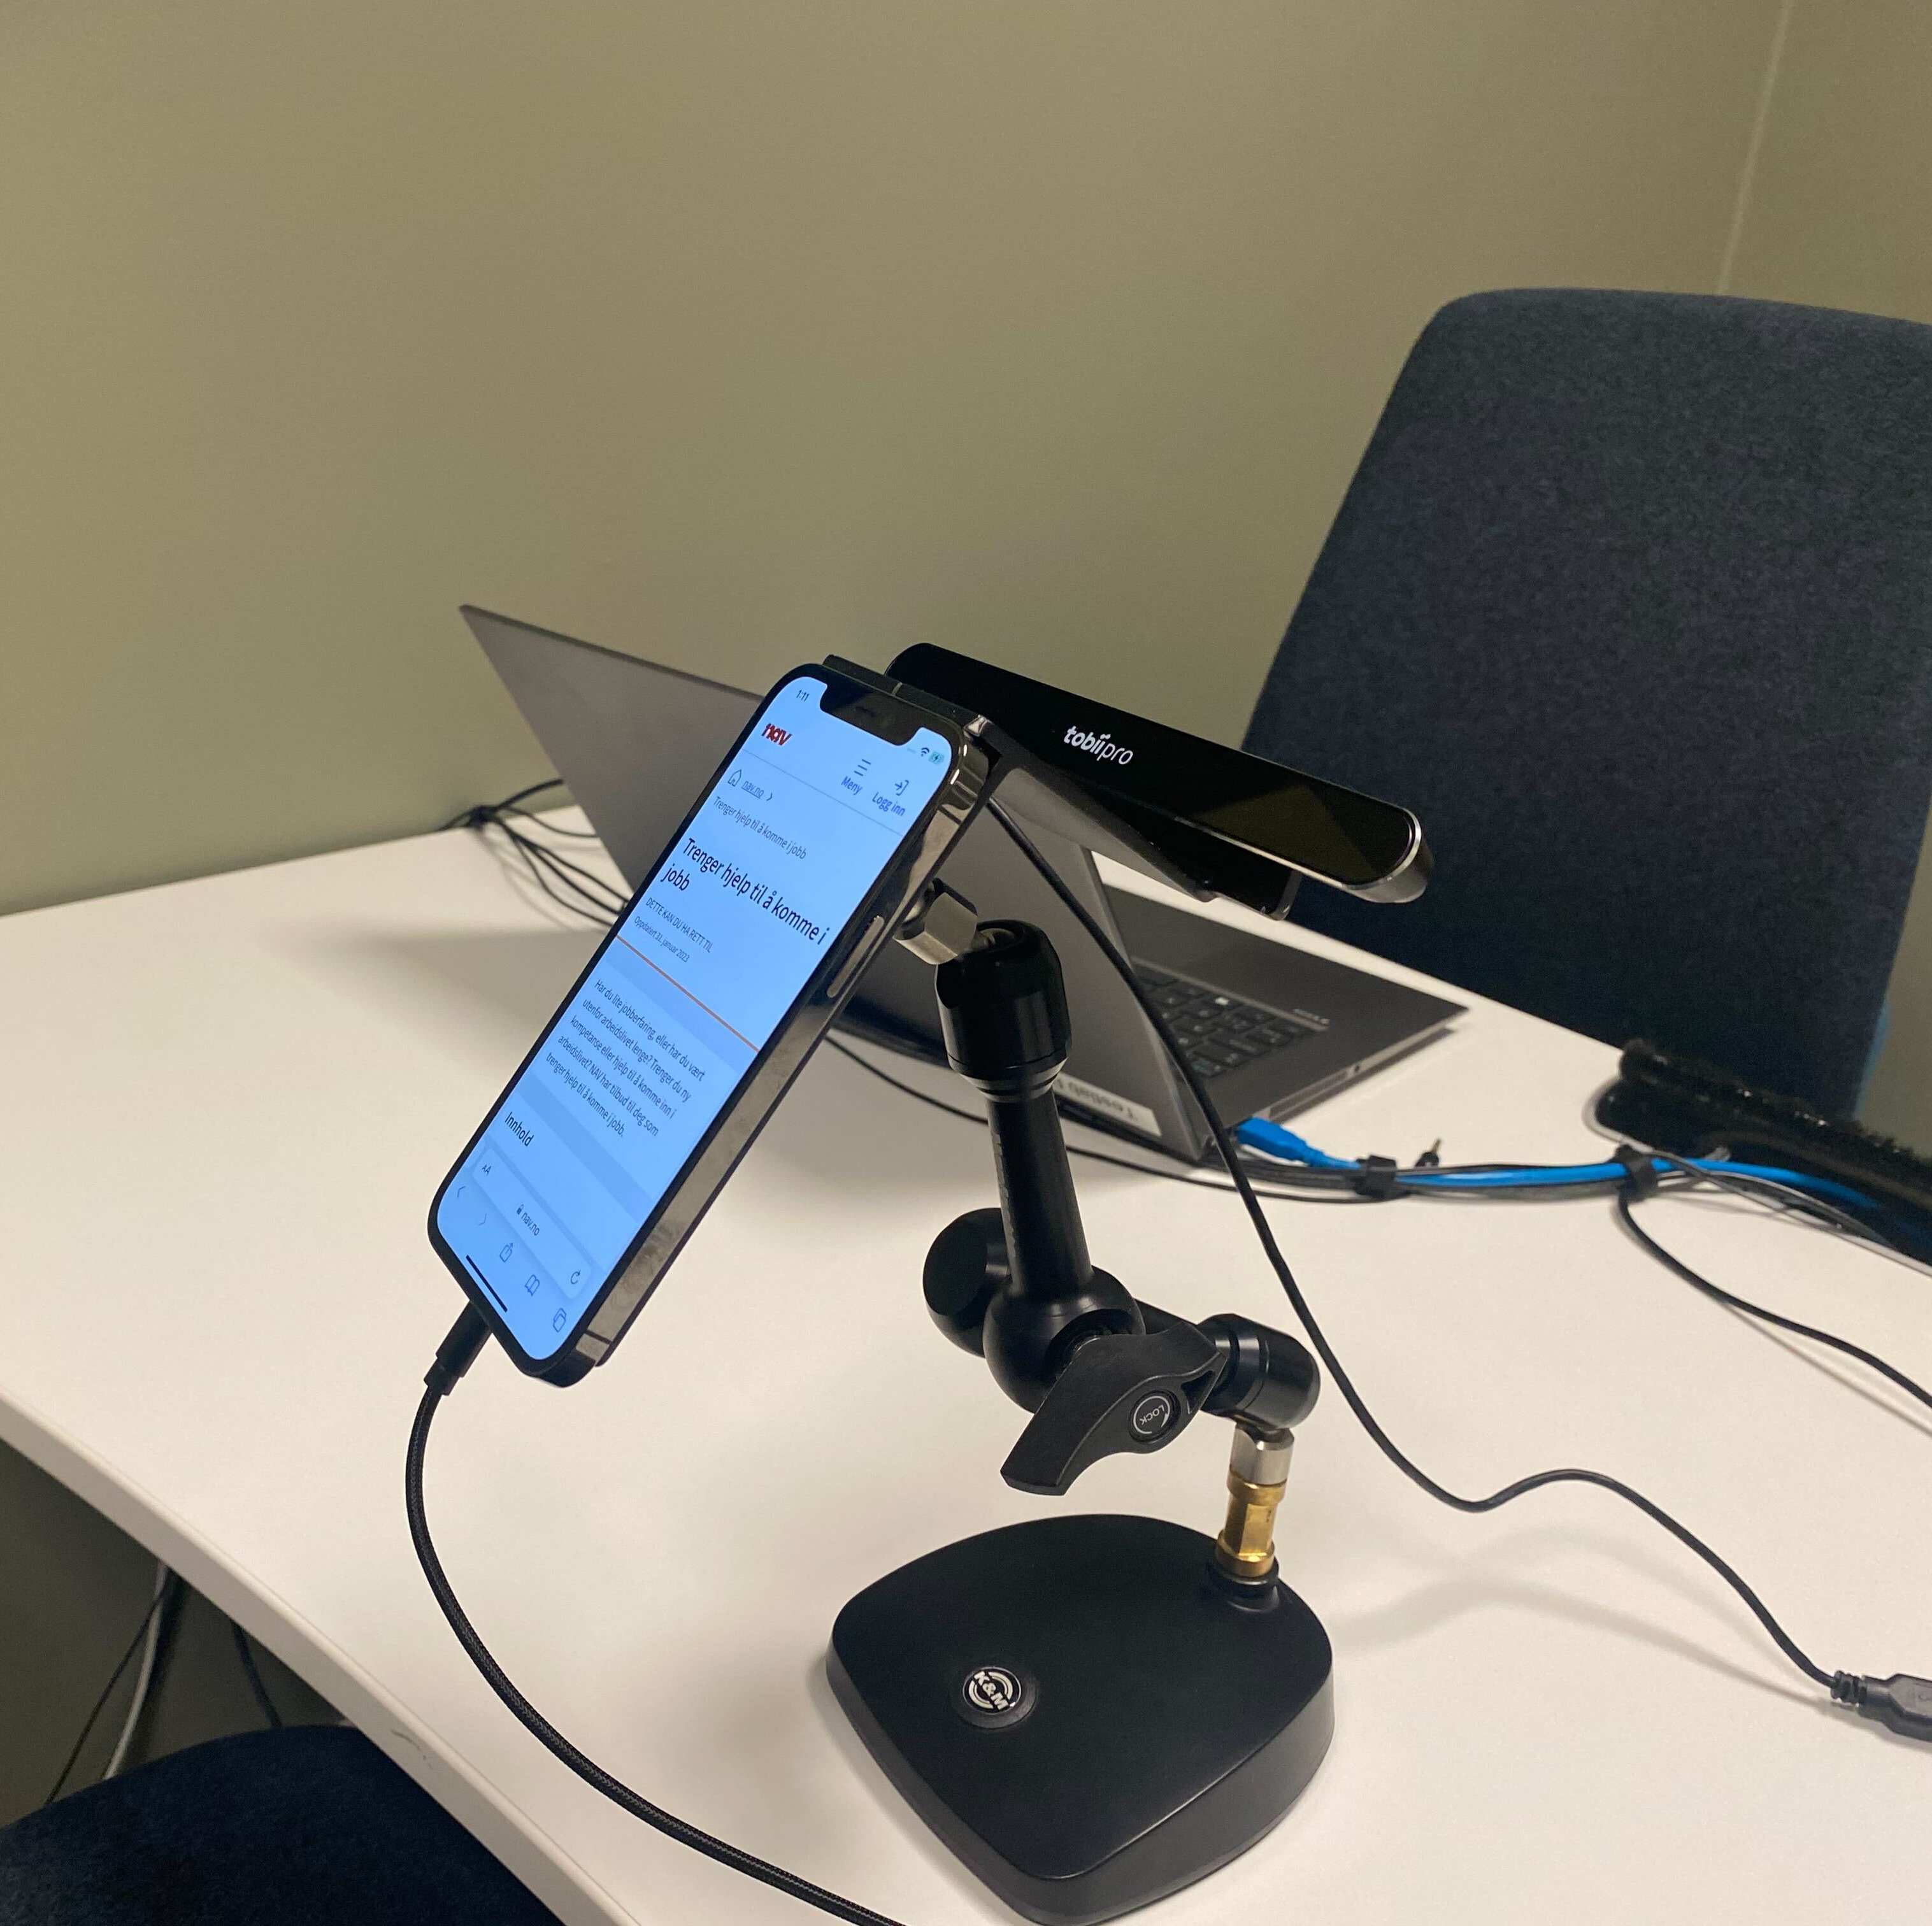
Test lab with mobile devices and eye tracking

Slide 13
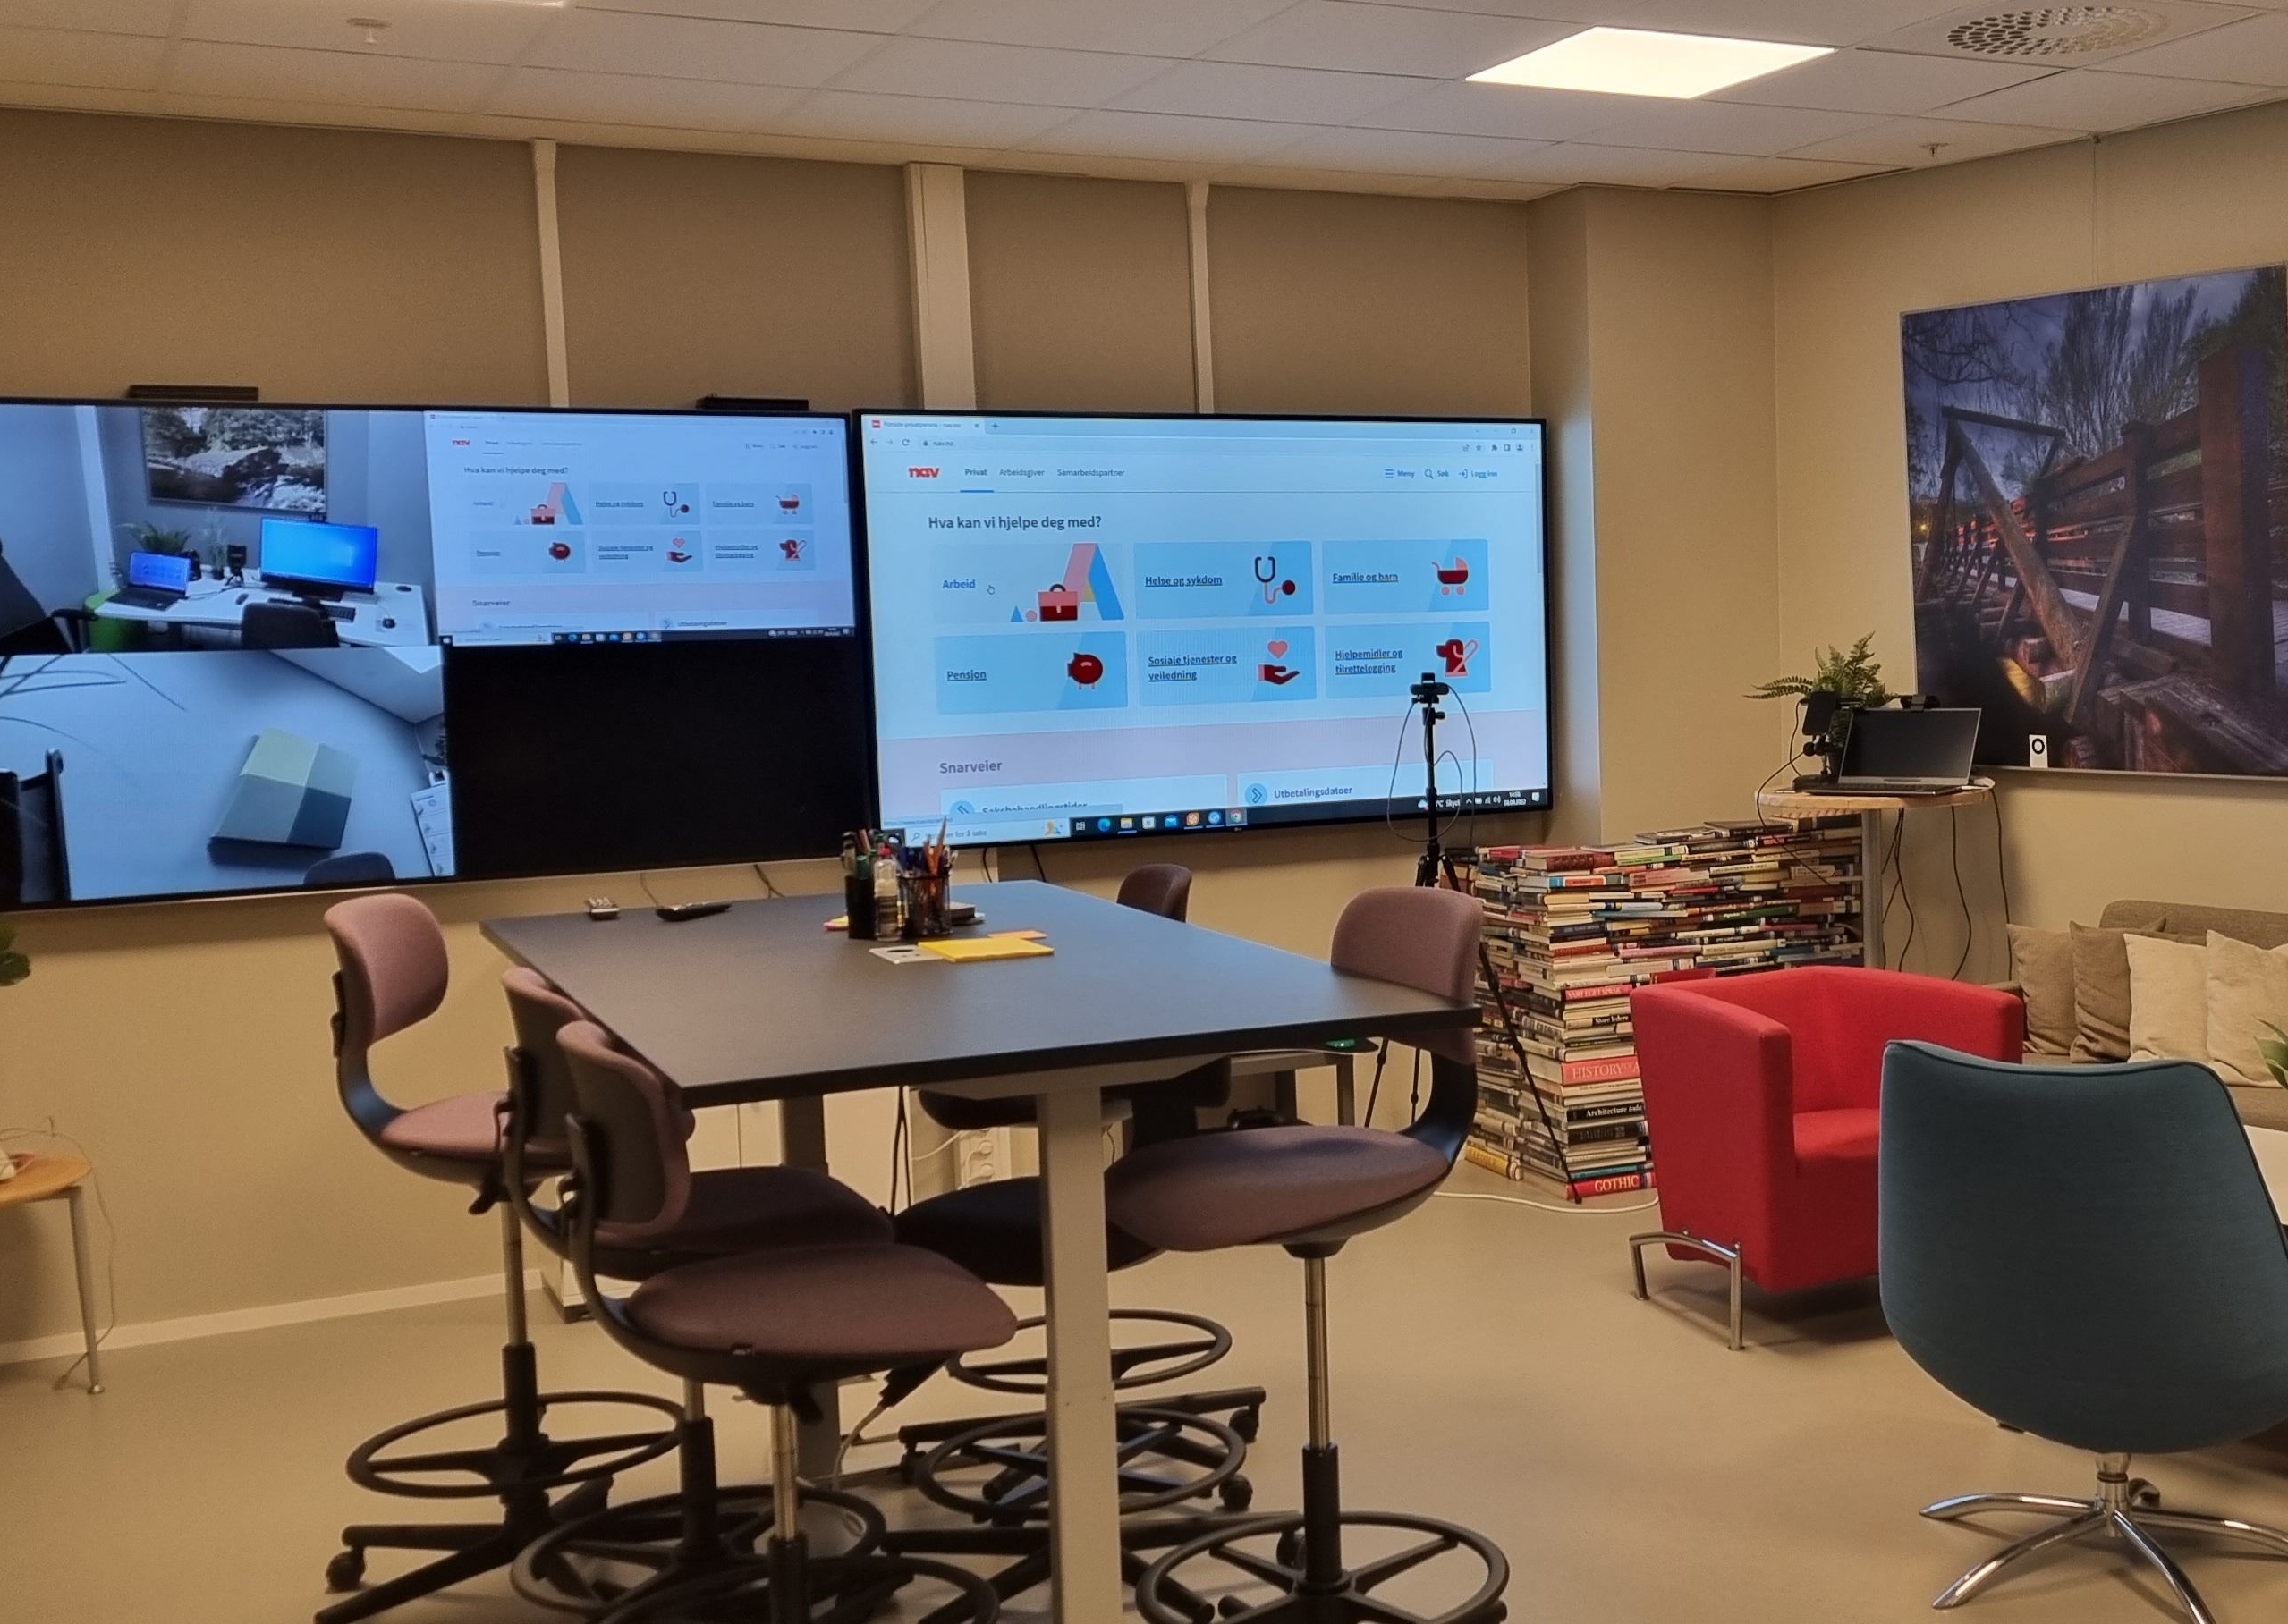
Test lab observation room

Slide 14
Accessibility statement
Required by law
Websites: February 1st 2023
Mobile apps: February 1st 2024
A declaration about the state of accessibility
Usually one per website
How to create one for all the webpages on nav.no?

Slide 15
Tender processes
Defining criteria for selection
Doing summary reviews
Working with providers

Slide 16
Other team activities
Interpreting the law
“Diversity in May” (mangfoldimai.no)
Cooperation with other organizations
Notes:
Norsk helsenett – Norwegian Health Services
Oslo Origo
Skatteetaten – The Norwegian Tax Administration

Slide 17

Aksel
The design system team

Slide 18

Who are Aksel?
5 Developers
3 Designers
Accessibility Specialist
Product Owner
Head of Brand

Slide 19
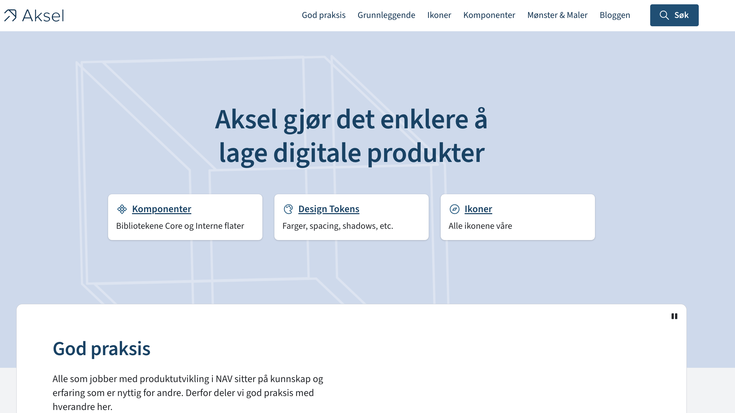
Notes:
Slow-paced
Standardization, not driving innovation
We don’t want to innovate
Teams build stuff, we adopt it when it has been proven to be a good solution
Scaling (everything we build saves up to 80 times that work)

Slide 20
Aksel component library
50+ React components
Separate CSS
User testing is done in product teams
Feedback loop is important!

Slide 21
Best practice articles
Blogs and articles
Sharing for internal teams but open for all
Accessibility is topic #1

Slide 22





Tools

Slide 23
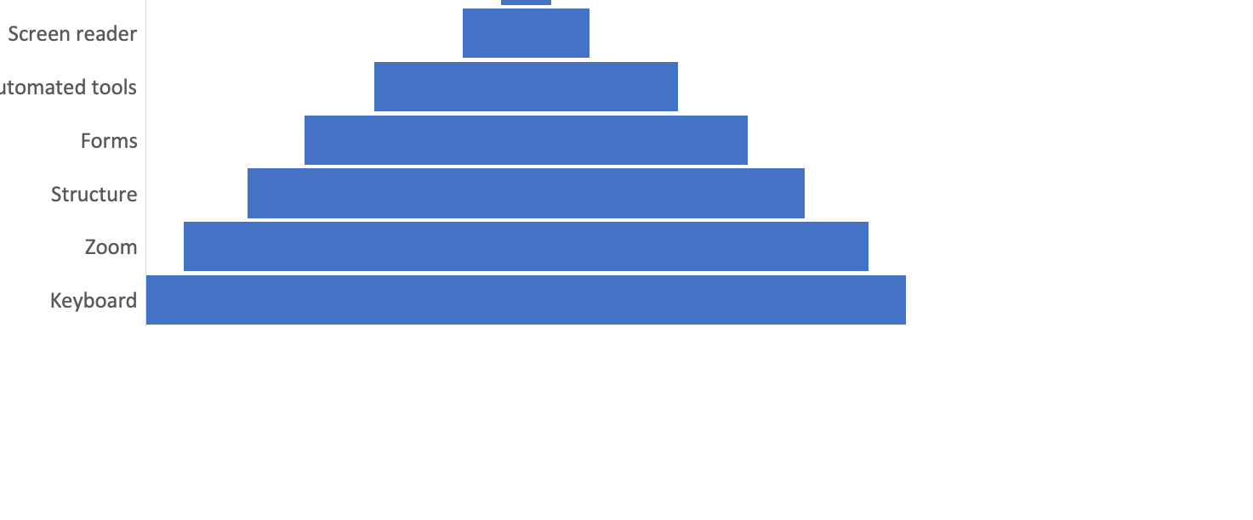
My accessibility testing pyramid

Slide 24





Automated testing
Notes:
Of course, it varies somewhat between teams, but usually they use some combination of
React testing library
Axe from Deque
And some linting plugin for whatever setup we use, like ESLint
In addition, we often use SiteImprove for monitoring and reporting accessibility issues,
and also Accessibility Insights to do assisted, semi-automatic testing.

Slide 25
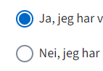
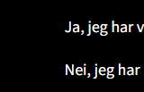
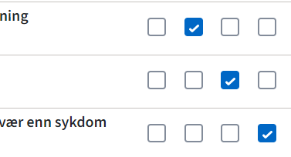
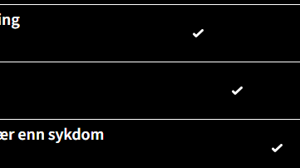
Windows High Contrast mode gone wrong
“Hi, we just received an issue from a user with low vision impairment. He uses High Contrast mode on Windows. And it just ... does not appear to work…”
Box shadow does NOT work in High Contrast mode!
Border-radius now works for outline.
Combined @media (forced-colors: active) with CSS system colors as a temporary fix

Slide 26
What do I want you to remember from today?
Accessibility training is important
Don’t depend on one “guiding star”
Scale accessibility work to fit your organization
Your organization is responsible for accessibility of off-the-shelf products
A design system is worth the investment
Much of the most impactful testing is really cheap, but don’t forget to involve real users!

